Slide 1
HDFS Architecture
HDFS has Master slave architecture
Comprises NameNode & number of DataNodes

Slide 2
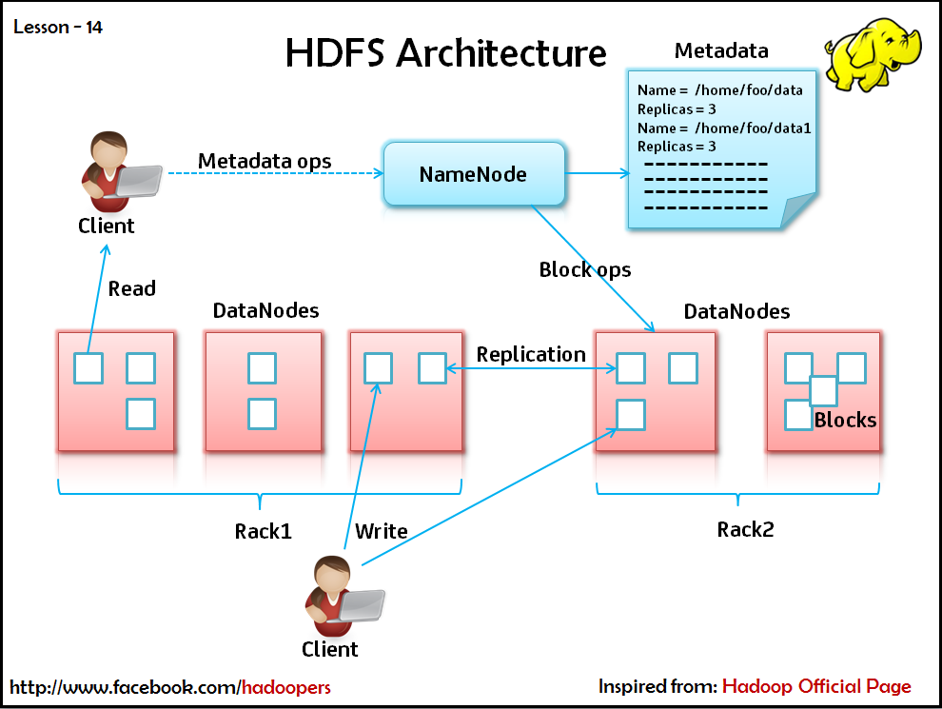

Slide 3
Concept of Blocks
Disk has certain block size
File Systems expand by managing information in pieces
File System blocks-couple of KB
Disk Blocks-512 bytes
Seek time is 1% of exchange time
Seek time-10ms Exchange time-100 MB/s
Default size-64 MB

Slide 4
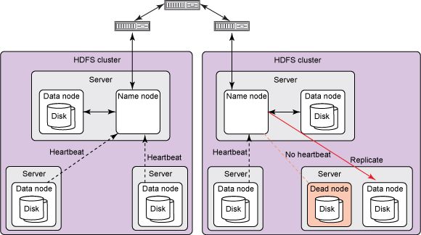

Slide 5
Process to be Implemented
Monitoring
Rebalancing
Metadata Replication

Slide 6
Hadoop Specific file systems
Local
HDFS
HFTP
HSFTP
HAR
KFS
FTP
S3

